Slide 1
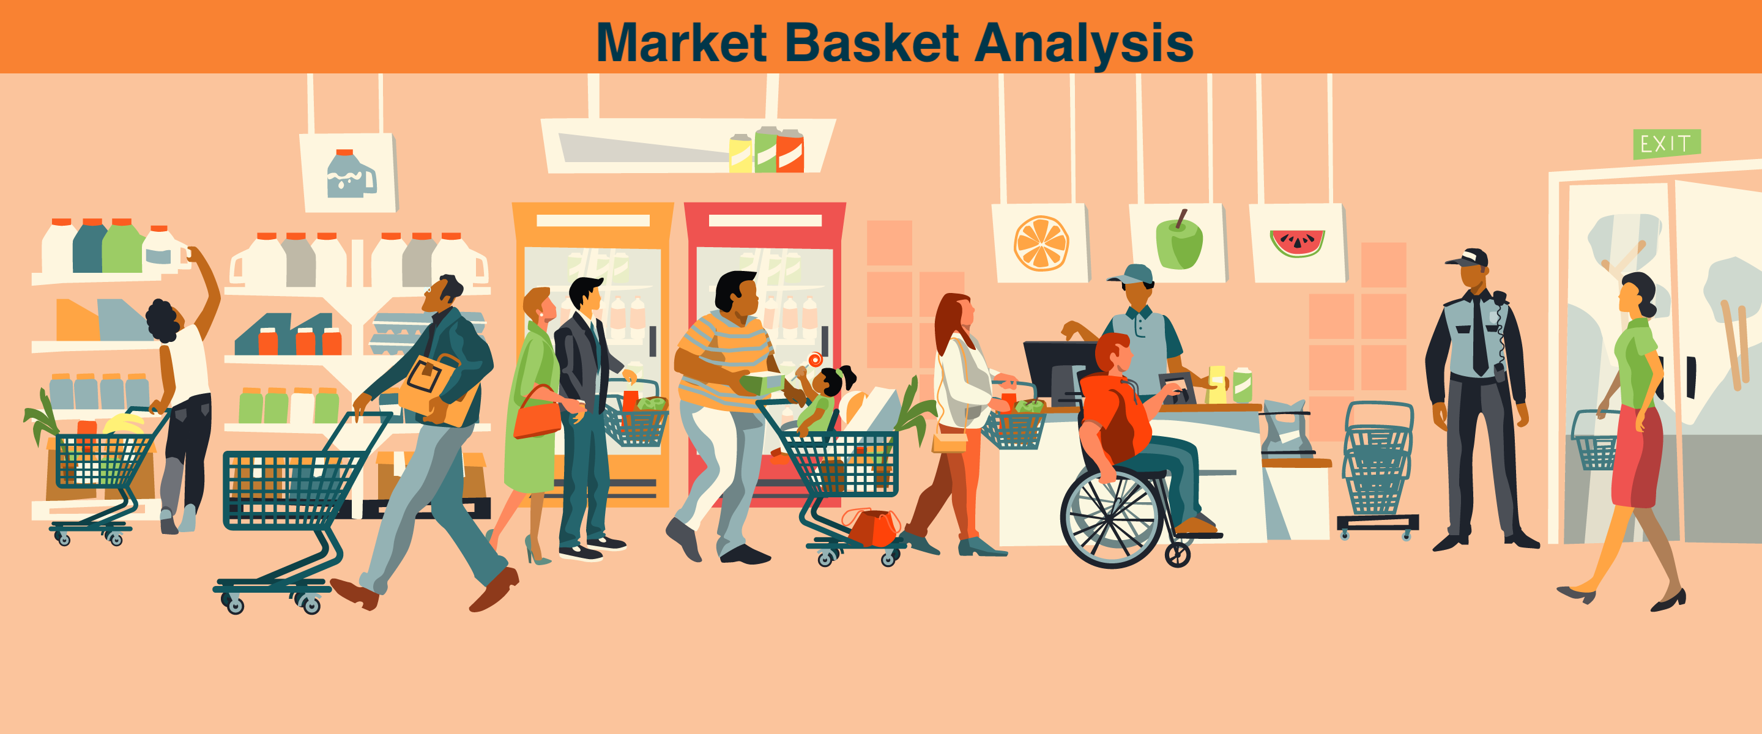
MARKET BASKET ANALYSIS FOR RETAIL BUSINESS
USING PYTHON
BY:_Partha sarathi behuria
Dept.of Management
Final Year
UTKAL UNIVERSITY

Slide 2
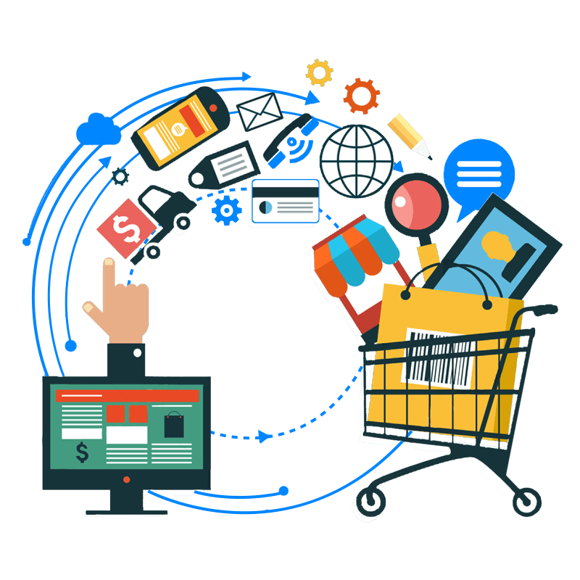


CONTENTS
1) Introduction
2) Data collection
3) Data reprocessing
4) Generating Frequent itemsets
5) Visualization
6) Case studies & Applications
7) Summary

Slide 3
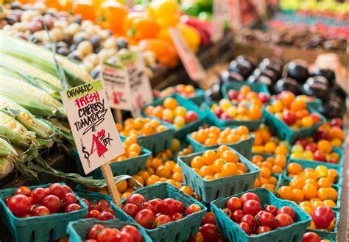
Introduction
Market Basket Analysis is a crucial technique in retail management that helps retailers understand the purchase behaviors of their customers. By analyzing transactional data, MBA identifies associations between products frequently purchased together. This understanding enables retailers & wholesalers to make informed decisions on product placement, promotions, and inventory management strategies

Slide 4
DATA COLLECTION
Data collection is a foundational step in market basket analysis for retail management. It involves gathering transactional data that records the items purchased together in each transaction. Here’s a detailed overview of data collection :-
Methods of Data Collection:
Point of Sale (POS) Systems: Retailers can collect transactional data directly from their POS systems, which automatically record each sale made at checkout. POS data is typically structured and includes transaction IDs, items purchased, and timestamps.
Surveys and Feedback: Occasionally, retailers may collect additional data through customer surveys or feedback forms. This qualitative data can supplement transactional data by providing insights into customer motivations and purchasing decisions.

Slide 5
DATA REPROCESSING
Data reprocessing is a critical step in market basket analysis that involves transforming raw transactional data into a structured format suitable for analysis. Here’s a detailed overview of data reprocessing steps typically involved in the process:
a) Data cleaning_handle any missing data in transactional records.
b) Data Transformation_Transform the transactional data into a format suitable for algorithms to perform.
c) Data Filtering_: Filter out infrequent/unnecessary items that do not contribute significantly to the analysis.
d) Data Integration_Integrate supplementary data such as customer demographics, product categories, or sales data
e) Data Formatting_Ensure the data is formatted in a way that MBA algorithms can process efficiently.

Slide 6
Generating frequent itemsets is a fundamental task in market basket analysis to identify combinations of items that frequently occur together in transactions. Here’s a step-by-step guide on how to generate frequent itemsets using Python and the Numpy libraries :-
STEP BY STEP GUIDE:-
Install Required Libraries-Make sure you have pandas and Numpy installed.
Import Necessary Libraries-Then we have to import the necessary libraries required for the operation.
Prepare Transactional Data-Define your transactional dataset. Each transaction should be represented as a list of items.
Generate Frequent itemsets- This parameter specifies the support threshold for an itemset to be frequent or basically the frequency pattern of a product.
​

Slide 7
VISUALIZATION
Visualizing market basket analysis results is crucial for understanding item associations and patterns in transactional data. Here are several effective visualization techniques you can use to present and interpret market basket analysis findings:-
Support Visualization- Plotting support values for each itemset can provide a quick overview of itemset frequencies. This helps in identifying the most frequent itemsets in the dataset.
Parallel Coordinates Plot Visualization- Display multiple association rules simultaneously using parallel coordinates to visualize relationships between antecedents, consequents, support, and confidence.

Slide 8
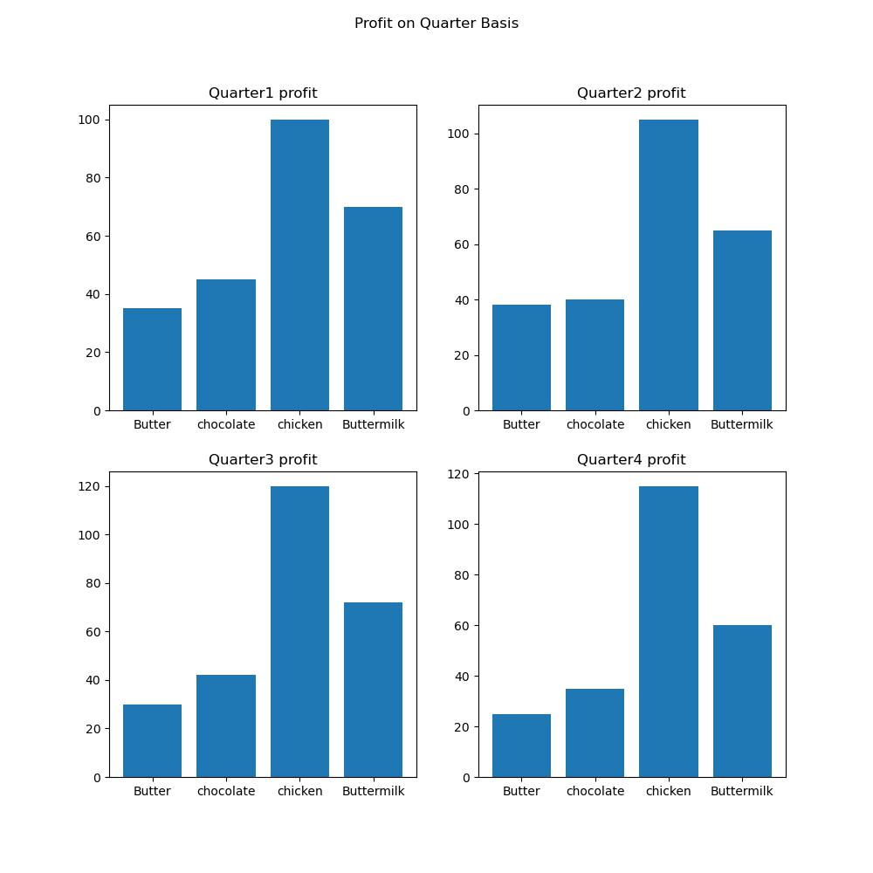
So, these are 4 bar charts in one single image.These basically show the profit percent of 4 different commodities of Reliance Fresh in 4 different quarters.we can clearly observe that the commodity(chicken) generates the higher profit value in all the four quarters in a single year and the rest commodities keeps on increasing & decreasing variably.

Slide 9
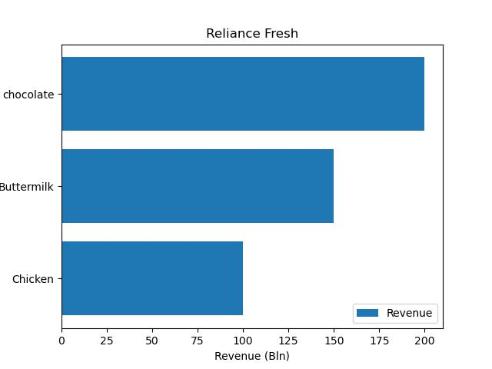
So this is a Horizontal bar chart using barh function. This basically shows the Revenue(in crores) of different commodities at Reliance fresh. We can clearly interpret that the commodity(chocolate) generates the highest revenue in the respected year and the other commodities thereafter generates less revenue as compared to the first one.

Slide 10
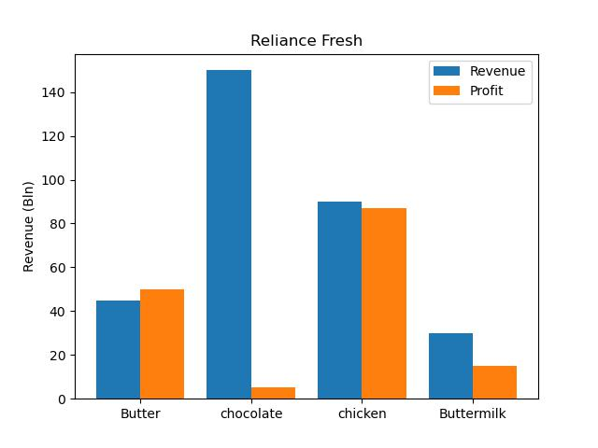
So this image depicts various multiple bars showing revenue & profit of various commodities at Reliance fresh(in crores). We can clearly interpret that the commodity (butter) & (chicken) is at a stable stage generating equal amount of revenue & profit whereas chocolate & buttermilk is at unstabilized form their revenue & profit graph clearly shows the disruptions in their way.

Slide 11
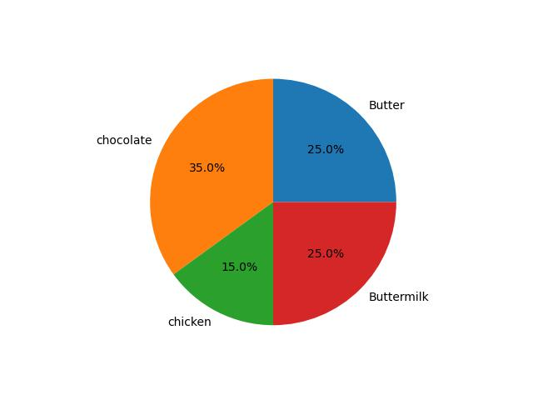
So this is a basically a pie chart depicting the market percentage & profit value of various commodities in the marketplace. We can clearly interpret that chocolate holds a better position in the market with high profit value as compared to other items. Butter and buttermilk holds the equal market percentage & equal profit value. Whereas chicken holds the lesser profit value as compared to the rest commodities.

Slide 12
CASE STUDIES & APPLICATIONS
Retail Industry:
Supermarkets: Retailers like grocery stores use market basket analysis to optimize product placement. For example, Analysis shows that customers who buy bread also tend to buy milk, butter. These products might be placed closer together to encourage additional purchases together.
Online Retail Industry: E-commerce platforms use market basket analysis to personalize recommendations. For instance, if a customer adds a camera to their cart, the platform might suggest complementary items such as memory cards or tripods based on previous purchasing patterns. If he adds a mobile to his cart he will be suggested of mobile covers, screen guards, earphones, airdopes etc.

Slide 13
SUMMARY
Market Basket Analysis is an effective way to uncover relationships between items in transactional data. By leveraging powerful libraries like Pandas, Numpy & MatplotLib the process of preparing data, generating frequent itemsets, Visualization and extracting association rules becomes streamlined and efficient for a shopkeeper,wholesaler & Retailer.

Slide 14
THANK YOU

